Slide 1
Revature India Pvt. Ltd.
Week 4- Team project (P1)
Associates Training Management
Trainer:
Mr. Prinshsu Verma
(Big- data specialist at Revature )
Team :
Piyush Goyal (TL)
Aysha Musktesar
Surya Dev Gedela
Bhavana Priya
GitHub :- https://bit.ly/2Y5Slbn
External:
Ms. Saundarya Paul
(Big- data specialist at Revature )

Slide 2
Roles and Responsibility
Bhawana Priya – Data Collection & Pre-processing
Piyush Goyal – Data-Base Management
Surya Dev Gedela – Data Analytics
Aysha Muktesar – Quality & Deployment Manager

Slide 3
Description
This is Our Project Which is created in hive (Data Warehouse software, built in top of Hadoop). Which create and maintain the database of all associates trainings of various courses. In this Project we performed many different – different operations like table join, updating, creating etc, these operations are done on tables, we have 4 tables in this project.
Also we perform many various queries on these tables, we have 2 CSV data-sets, which are very useful for data loading, using queries we extract the data.
We run this project on GCP ( dataproc → cluster → hive ), there is no UI ( user Interface ) for better experience.
Delivered this project on Git-Hub:-
Link :- https://bit.ly/2Y5Slbn

Slide 4
Tools & technology
GCP ( Google Cloud Platform) – Run the project and output
GitHub – Deploy the Whole Project here
Hadoop – Main system
Hive – For Data WareHouse
MS Excel – Store the data Set
MS PowerPoint – For Presentation
MS Word – For WorkFlow
Notepad – CSV to txt file format

Slide 5
features
Effective Discount on every course.
Installment payment for Economically Weaker Section people.
Reschedule facility for Demo Missed and Demo Not Done Associates.
There are many courses.
Joining and Demo available Weekdays as well as WEEKENDS.
Fees Due data facility available if student forgot the data.
Update all records from Master Table using ORC.
Create another Data Set for Payment table because it has more features …

Slide 6
Key-Notes
Make this more flexible.
Will Integrate with UI.
Grab the data in real time scenario.
Secure all DB at Admin Panel
Try to make a web app and integrate with this DB.
Deploy this project on AWS( For Faster Response ).
Provide some referral cash back for each & every Associates.

Slide 7
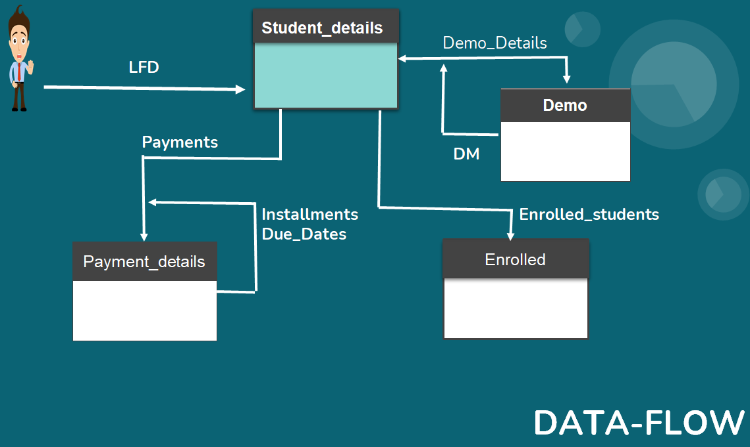

Slide 8
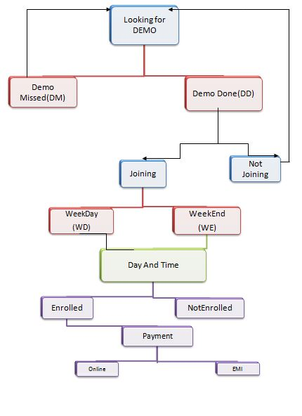
Work Flow

Slide 9
ORC
The Optimized Row Columnar (ORC) file format provides a highly efficient way to store Hive data. It was designed to overcome limitations of the other Hive file formats. Using ORC files improves performance when Hive is reading, writing, and processing data.
a single file as the output of each task, which reduces the NameNode's load.
block-mode compression based on data type
run-length encoding for integer columns
dictionary encoding for string columns

Slide 10
ACID
Acid properties for table in hive:-
set hive.support.concurrency = true;
set hive.enforce.bucketing = true;
set hive.exec.dynamic.partition.mode = nonstrict;
set hive.txn.manager=org.apache.hadoop.hive.ql.lockmgr.DbTxnManager;
set hive.compactor.initiator.on = true;

Slide 11
Why ORC?
reason why we create extra temp table to transfer data into master table:-
It is not possible to directly load a text file into a ORC table. Steps to load data into ORC file format in hive:
1.Create one normal table using textFile format.
2.Load the data normally into this table.
3.Create one table with the schema of the expected results of your normal hive table using stored as orcfile.
4.Insert/overwrite query to copy the data from textFile table to orcfile table.

Slide 12
All tables
1. Student_details : It have all data about associate and status1 and status2 hold the information about present condition of associate.
2. Demo_table: associate who done with demo are present in this table, here ‘id’ is the primary key.
3. enrolled table: if associate done with demo and he/she is joined the training are present in this table.
4. payment_details : there are many columns of associate details and here discount, installment, one time, due date columns are also here so it will make more flexible of this training, behalf of developer and associate point of view.

Slide 13
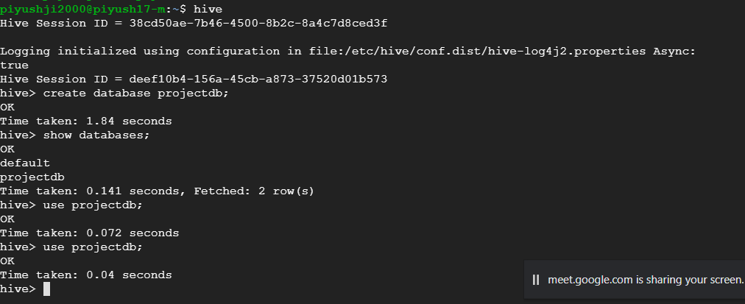
Create database
1. create database projectdb;
2. show databases;
3. use projectdb;

Slide 14
Create table and load commands
4. Create a text file format table and load the data
create table temp(id int, name string, mail string, mobile string, course string, age int, gender string, fee int, discount string, status1 string, status2 string)row format delimited fields terminated by ',' stored as textfile;
5. Load the data into this text file
laod data local inpath '/home/piyushji2000/Main_table1.csv/' into table temp;
6. Print the data using select command
Select * from temp;

Slide 15
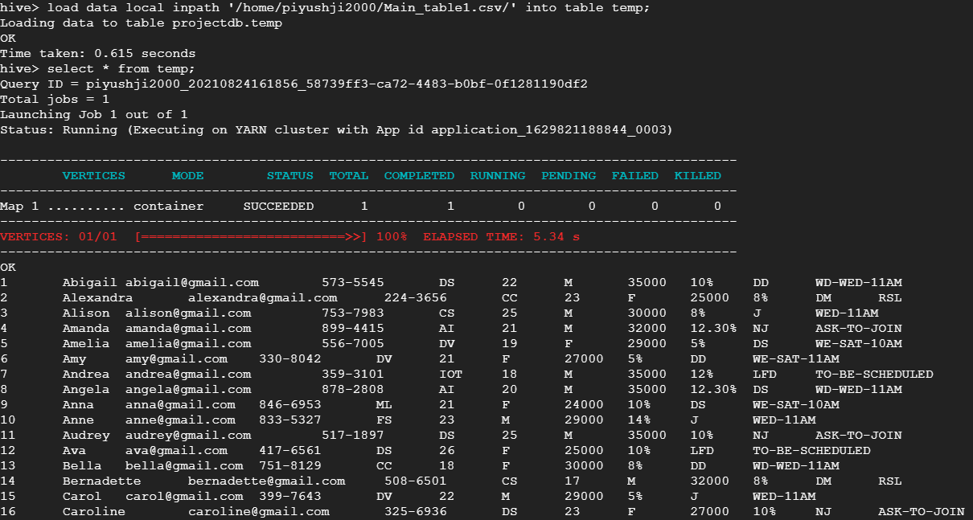
Create the table and load the data

Slide 16
Apply acid property and create orc table
ACID
Atomicity – Consistency – Isolation – Durability
7. Create a ORC table ;
create table Student_details(id int, name string, mail string, mobile string, course string, age int, gender string, fee int, discount string, status1 string, status2 string)stored as orc tblproperties('transactional'='true');
8. Insert the data from text table
insert into Student_details select * from temp;

Slide 17
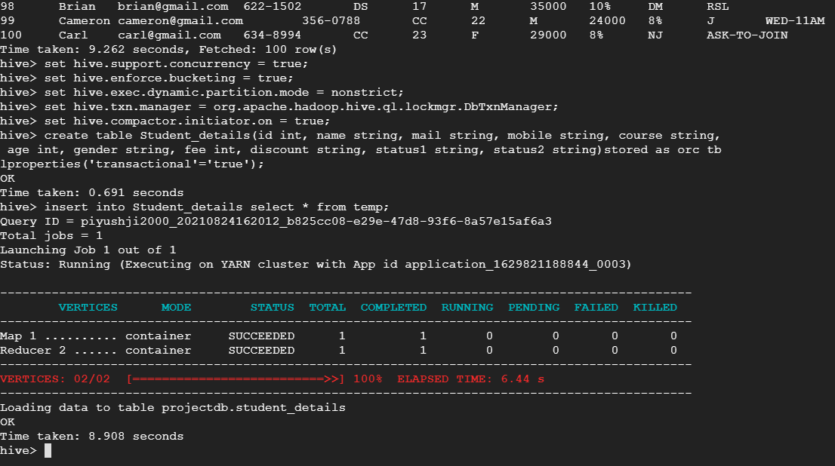
Apply ACID and create ORC table

Slide 18
Demo table and load data
9. Create Demo table
create table demo_table(id int, name string, mail string, contact string, course string, demo_status1 string, demo_status2 string)stored as orc tblproperties('transactional'='true');
10. Load the data from master table
Using Where CONDITION;
insert into demo_table select id,name,mail,mobile,course,status1,status2 from Student_details where status1='DS' or status1='DM' or status1 = 'DD';

Slide 19
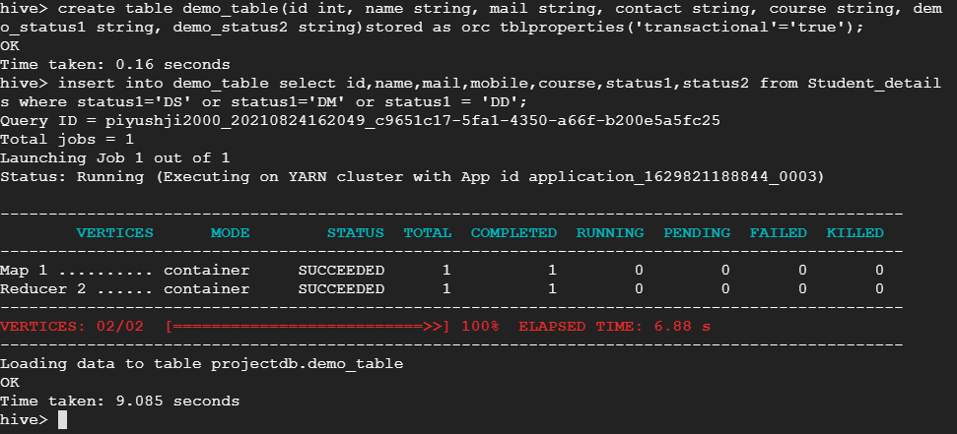
Create demo and load the data from master table

Slide 20
Create Enrolled table and load the data
11. Create Enrolled table in ORC format
create table enrolled(id int, name string, mail string, contact string, course string, enroll_status1 string, enroll_status2 string)stored as orc tblproperties('transactional'='true');
12. Load the data from Master Table
Using where condition (‘J’ = Joined )
insert into enrolled select id,name,mail,mobile,course,status1,status2 from Student_details where status1='J';

Slide 21
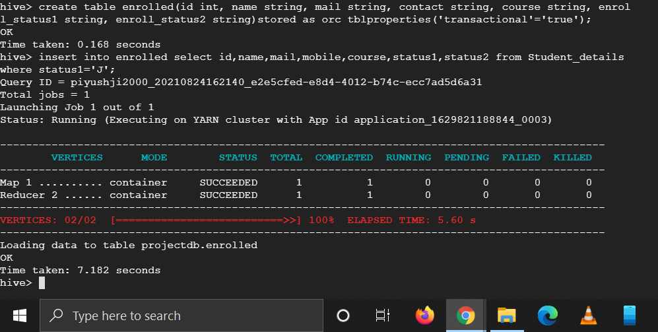
Create enrolled table and load the data from master table

Slide 22
create a temp. table and load the data
13. Create a text file format table
create table temp1(id int, name string, mail string, mobile string, course string, fee int, discount string, total_fee int, no_of_installment int, mode_of_payment string, deposite_fee int, remaining_fee int, fee_deposite_date string, due_date string) row format delimited fields terminated by ',' stored as textfile;
14. Load the data from LFS.
load data local inpath '/home/piyushji2000/payment_details.csv/' into table temp1;

Slide 23
Create payment table and load data data from temp table.
15. Create a payment_details in ORC file format
create table payment_detail(id int, name string, mail string, mobile string, course string, fee int, discount string, total_fee int, no_of_installment int, mode_of_payment string, deposite_fee int, remaining_fee int, fee_deposite_date string, due_date string)stored as orc tblproperties('transactional'='true');
16. Load the data from temp table
insert into payment_detail select * from temp1;

Slide 24
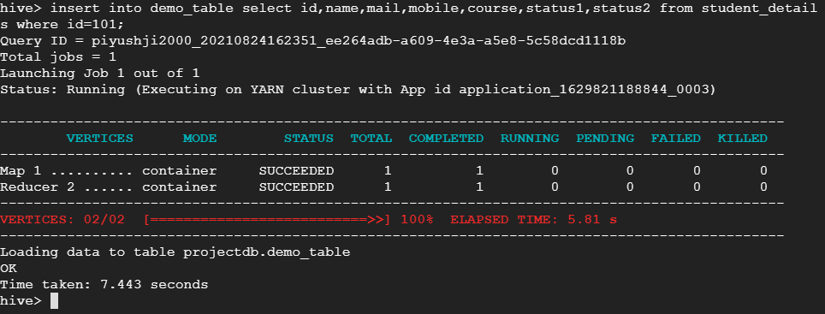
Insert the data into paymet_details

Slide 25
Update record adding data
18. insert the new record in mater table
insert into student_details values(101,'anand','anand@gmail.com','458-965','SQL',24,'M',25000,'15%','DD','WD-WED-11AM'),(102,'aysha','aysha@gmail.com','125-632','ML',21,'F',20000,'20%','J','WED-10AM');
19. insert data status1 is ‘DD’ its mean it should be in DEMO_TABLE so load this data in DEMO_TABLE.
insert into demo_table select id,name,mail,mobile,course,status1,status2 from student_details where id=101;

Slide 26
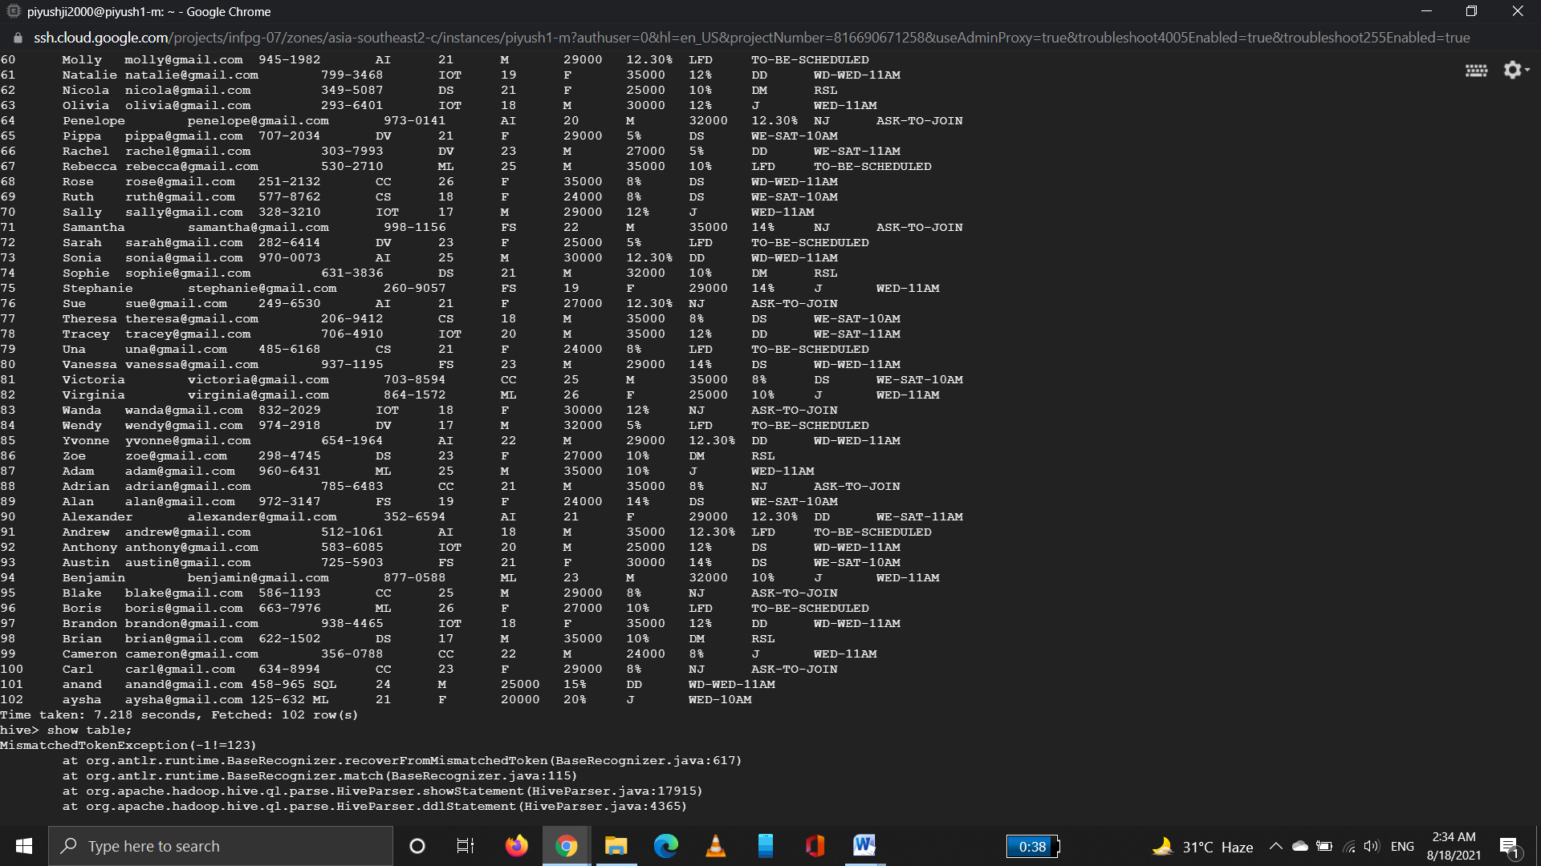
Update record

Slide 27
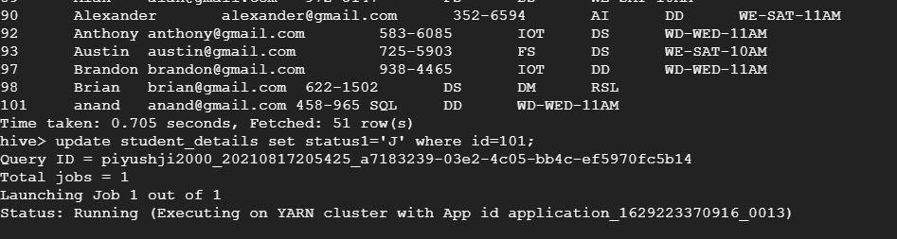
Update data into demo_table;
20. insert into demo_table select id,name,mail,mobile,course,status1,status2 from student_details where id=101;

Slide 28
Update data
21. Now I want to update a record from ‘DD’ to ‘J’ so now we update the data in student_table which is our Master Table.
update student_details set status1='J' where id=101;
22. Now we have to delete the data from DEMO_TABLE
delete from demo_table where id=101;

Slide 29
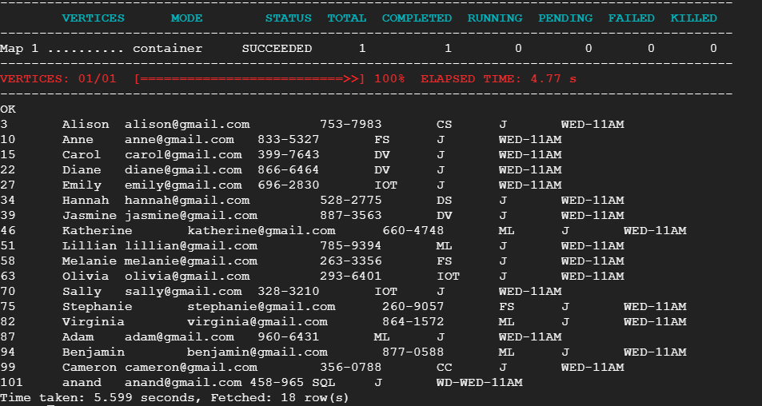
Update student From DD to Joined

Slide 30
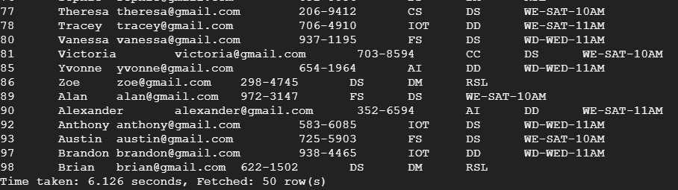
Delete in demo_table;
Data is reached at joined table so delete the data from demo_table;
delete from demo_table where id=101;

Slide 31
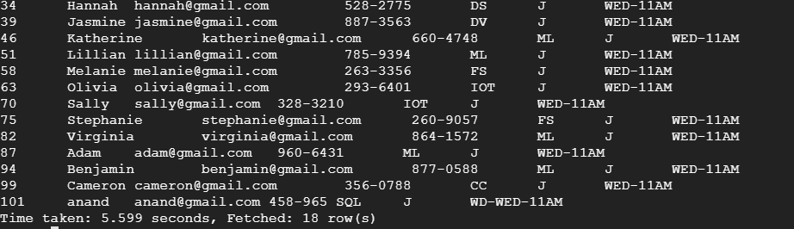
Insert the fee details in enrolled table;
Now student has joined our training.
23. insert into enrolled select id,name,mail,mobile,course,status1,status2 from student_details where id=101;

Slide 32
Some More queries
24. extract the status1 record of student
SELECT status1 from student_details where(id = 101)
25. Joining of 2 Tables
SELECT d.id,d.name,d.contact,d.course,d.demo_status1,d.demo_status2 from demo_table d JOIN enrolled e ON(d.id = e.id);
26. joining enrolled and payment_details
SELECT j.id,j.name,j.mail,j.contact,j.course,j.enroll_status1,j.enroll_status2 from enrolled j JOIN payment_detail p ON (j.id = p.id);

Slide 33
27. Find the installment
SELECT * from payment_details where (no_of_installment = 2);
28. Find the payment mode
SELECT * from payment_details where(mode_of_payment = online);
29. Find the next due date and total fee after discount
SELECT * from payment_details where ( id = xyz)
30. Find the all details about any candidates
SELECT * from student_details s JOIN payment_details p where (s.id = p.id)

Slide 34
JAI HIND
Thank you

